Slide 1
Amazon Prime Video
Poorani T

Slide 2


1.Import Python Libraries
pandas
numpy
matplotlib
seaborn
2.Load the Dataset from Drive

Slide 3
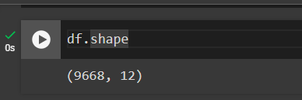

3.Data Understanding
9668 – Rows
12-Columns

Slide 4
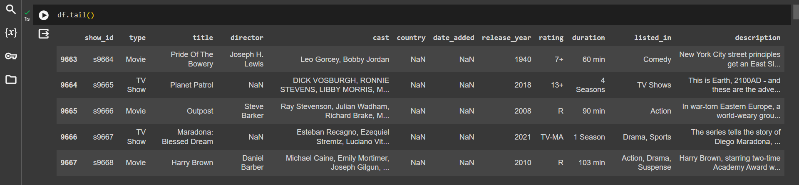


Slide 5
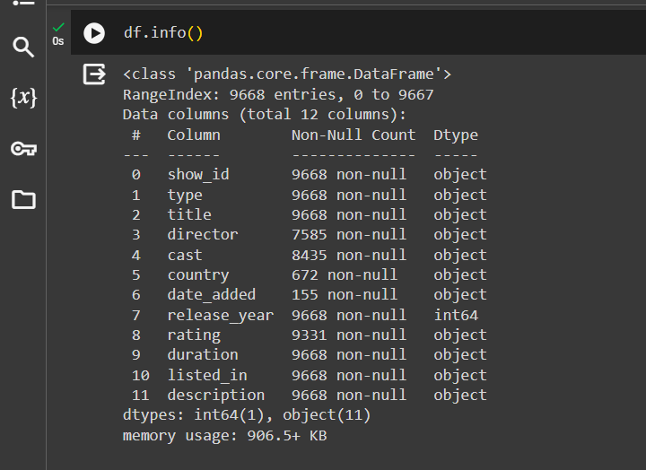
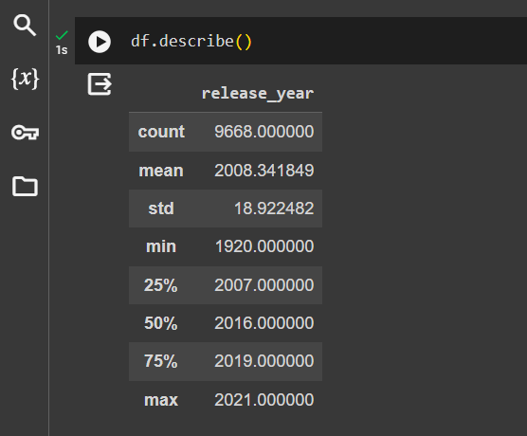

Slide 6
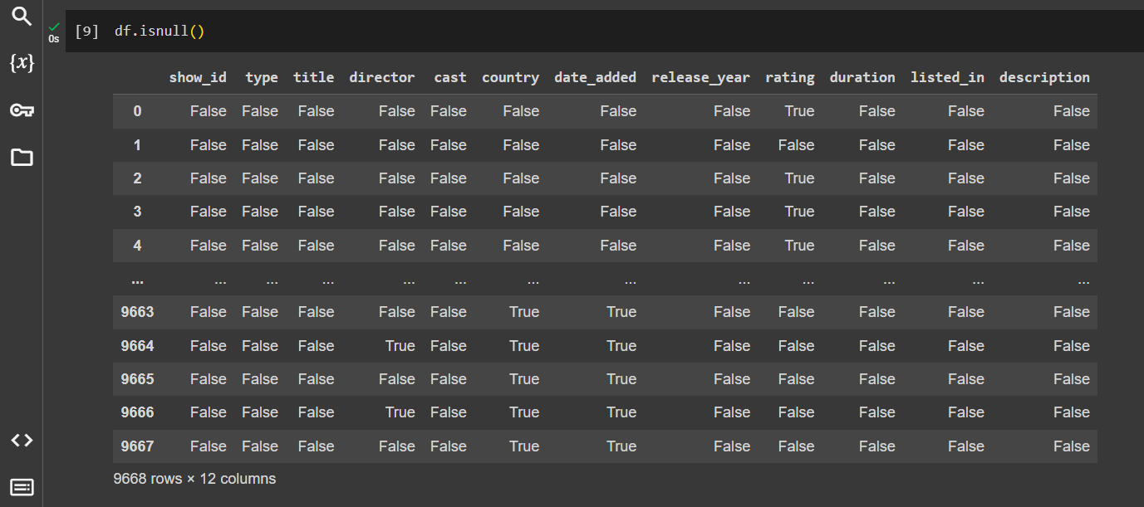
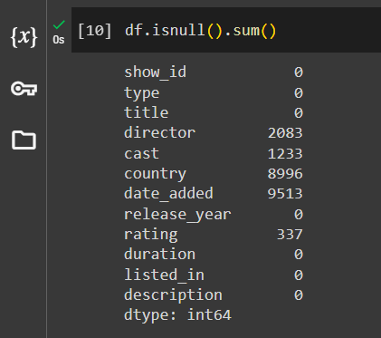
Null values
Sum of Null values present in specific columns

Slide 7

4.Drop the Column

Slide 8
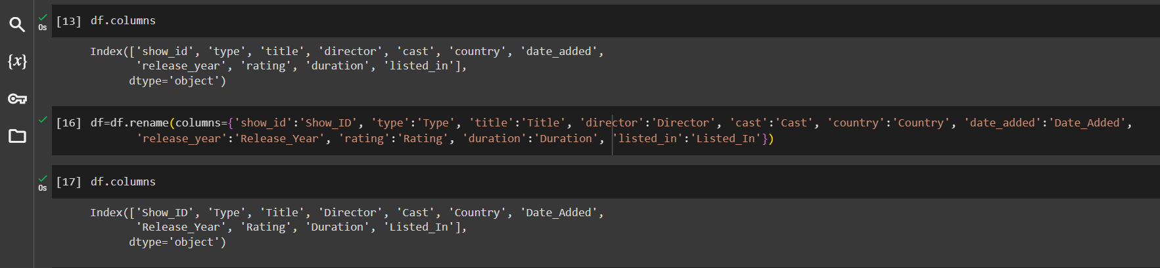
5.Rename the Column

Slide 9
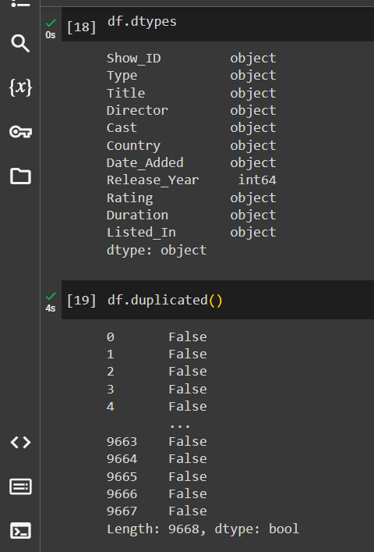
6.Datatype of the column and Duplicated values

Slide 10
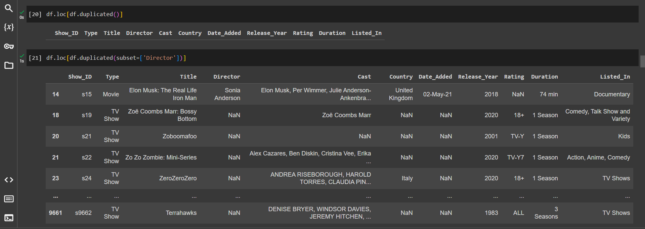
Duplicate Columns

Slide 11
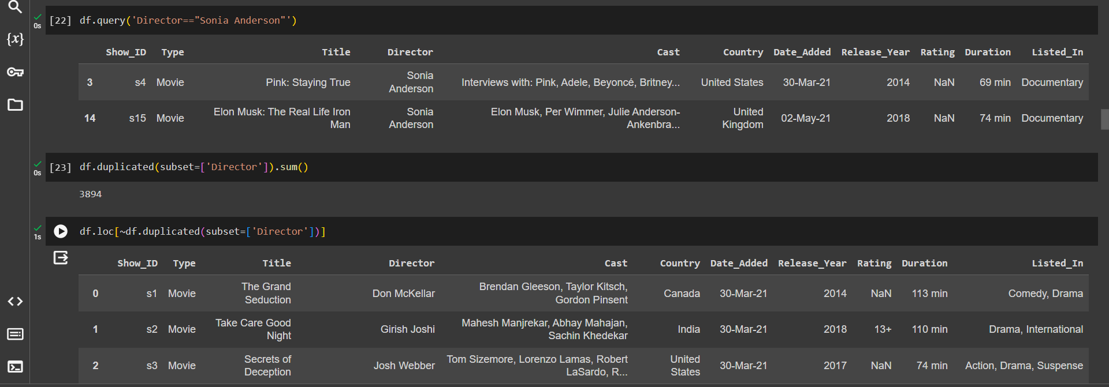
Add the two column which is duplicate

Slide 12
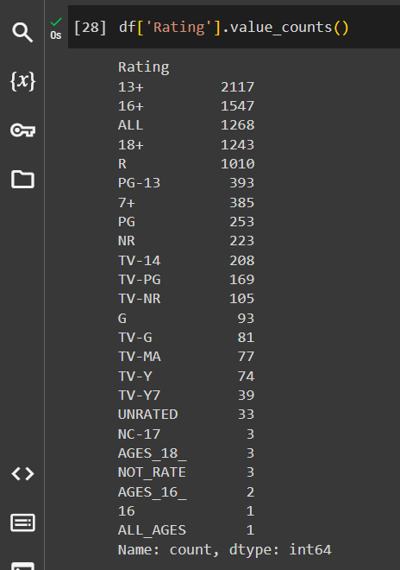
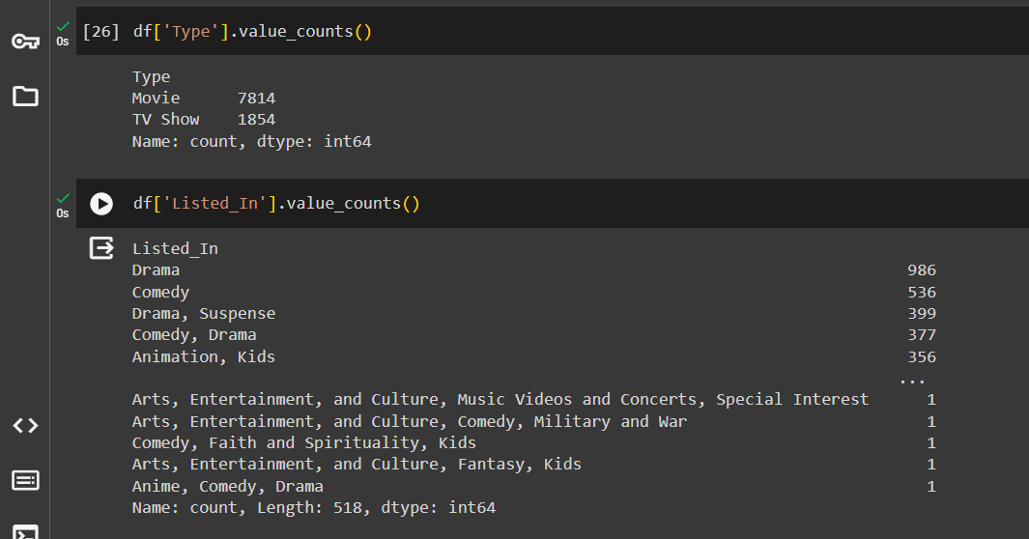
7.Count of Specific Columns

Slide 13
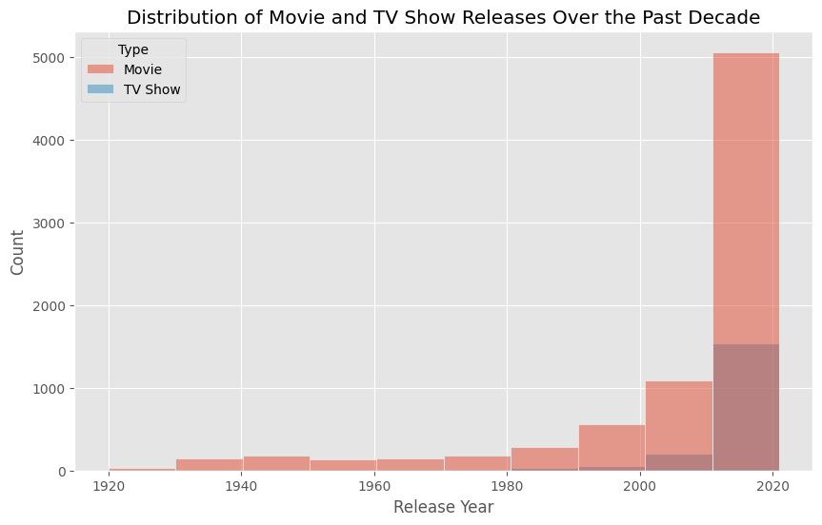
8.Visualization
How does the distribution of movie and TV show releases vary over the past decade on Amazon Prime Video?
plt.figure(figsize=(10, 6))
sns.histplot(data=df, x='Release_Year', hue='Type', bins=10)
plt.xlabel('Release Year')
plt.ylabel('Count')
plt.title('Distribution of Movie and TV Show Releases Over the Past Decade')
plt.show()

Slide 14
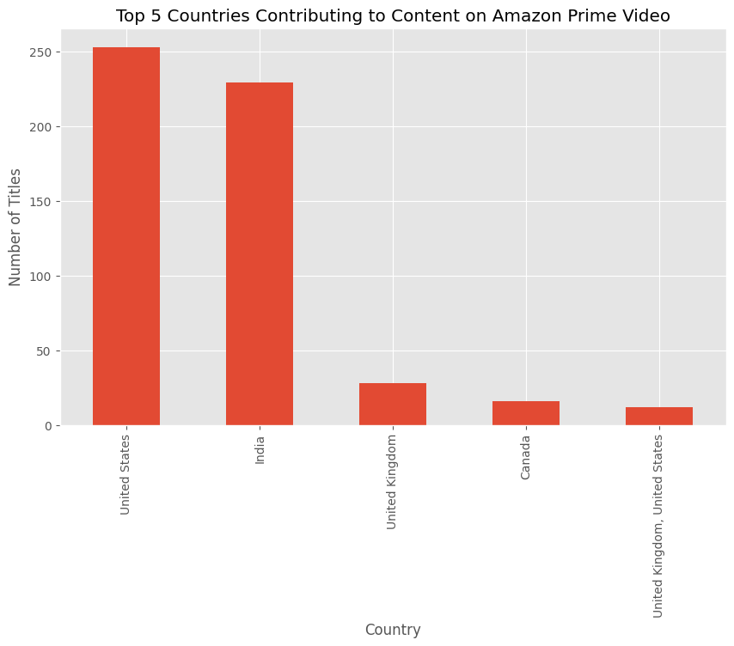
What are the top five countries contributing to the content available on Amazon Prime Video, and how do their contributions compare visually?
top_countries = df['Country'].value_counts().head(5)
plt.figure(figsize=(10, 6))
top_countries.plot(kind='bar')
plt.xlabel('Country')
plt.ylabel('Number of Titles')
plt.title('Top 5 Countries Contributing to Content on Amazon Prime Video')
plt.show()

Slide 15
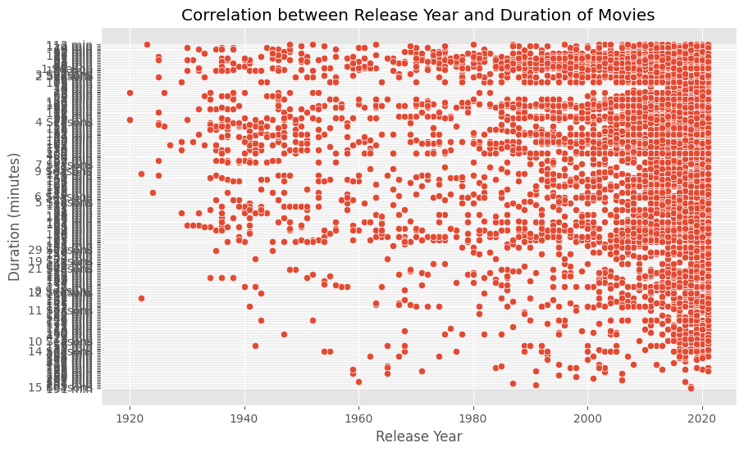
Is there a correlation between the release year and the duration of movies available on Amazon Prime Video?
plt.figure(figsize=(10, 6))
sns.scatterplot(data=df, x='Release_Year', y='Duration')
plt.xlabel('Release Year')
plt.ylabel('Duration (minutes)')
plt.title('Correlation between Release Year and Duration of Movies')
plt.show()

Slide 16
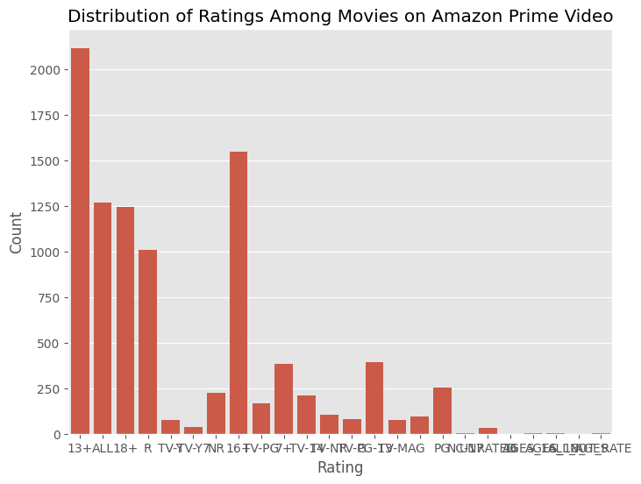
Show a bar chart representing the distribution of ratings (e.g., PG, PG-13, R) among the movies on Amazon Prime Video.
plt.figure(figsize=(8, 6))
sns.countplot(data=df, x='Rating')
plt.xlabel('Rating')
plt.ylabel('Count')
plt.title('Distribution of Ratings Among Movies on Amazon Prime Video')
plt.show()

Slide 17
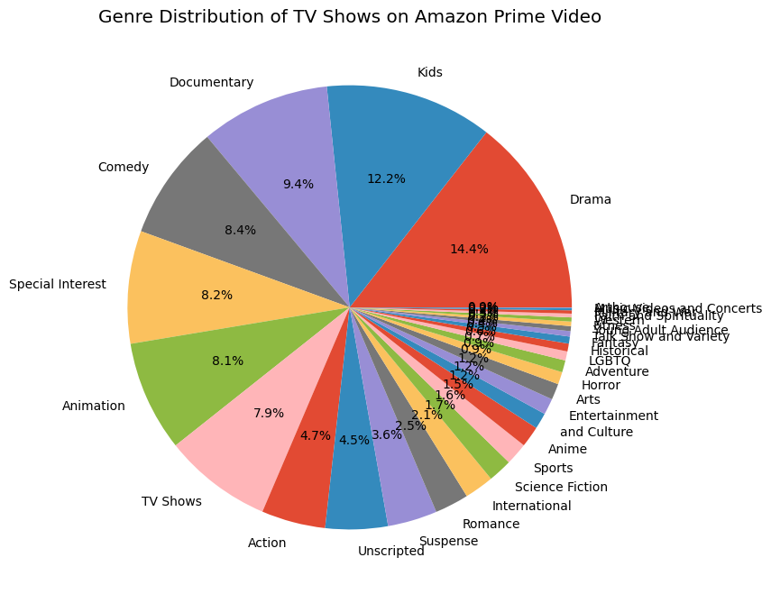
Create a pie chart illustrating the genre distribution of TV shows on Amazon Prime Video.
plt.figure(figsize=(8, 8))
df_tv = df[df['Type'] == 'TV Show']
df_tv['Listed_In'].str.split(', ').explode().value_counts().plot(kind='pie', autopct='%1.1f%%')
plt.title('Genre Distribution of TV Shows on Amazon Prime Video')
plt.ylabel('')
plt.show()

Slide 18
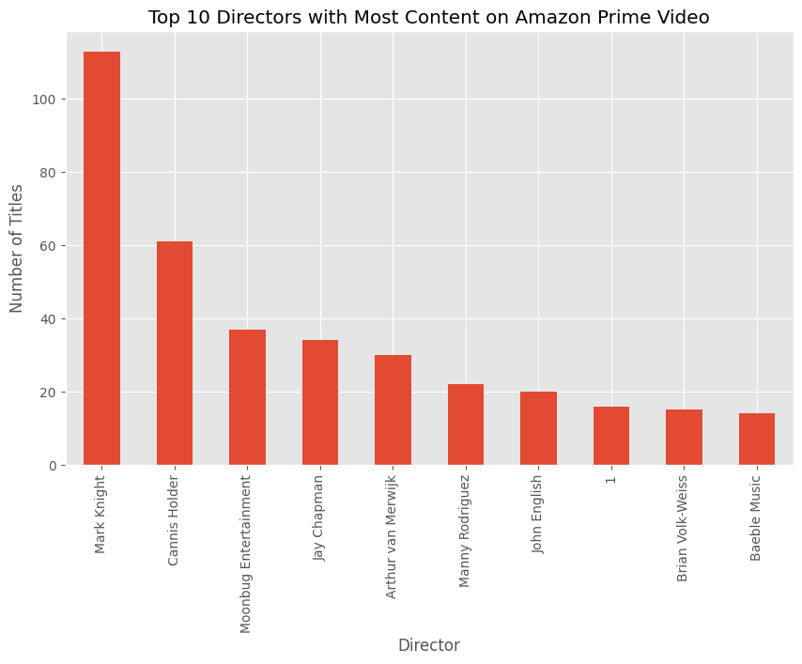
Visualize the top 10 directors with the most content available on Amazon Prime Video.
top_directors = df['Director'].value_counts().head(10)
plt.figure(figsize=(10, 6))
top_directors.plot(kind='bar')
plt.xlabel('Director')
plt.ylabel('Number of Titles')
plt.title('Top 10 Directors with Most Content on Amazon Prime Video')
plt.show()

